Slide 1
Our Good old team
Learnings from the past
Last updated: July 8, 2021

Slide 2
Why this deck
We had so many decks for our project: Intro deck, AOD for integrating teams, internal AOD for our team, Follow the data, Network components, Retrospective decks, etc.
We had covered almost all aspects of application, team, and integrations.. Each area was thoroughly documented and kept up-to-date.
But the circumstances beyond our control, fractured and broke our team in a bad way.
Even though as a team as well as individuals, each one of us contributed above and beyond to produce an application and support system of highest quality standard, most of us were thrown out of the organization altogether – there was no proper closure/ farewell to the individuals that departed away from the team
And hence this one-more-deck to bid adieu and reflect on the good memories/ learnings that we can take with us

Slide 3
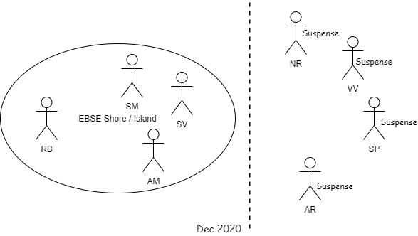

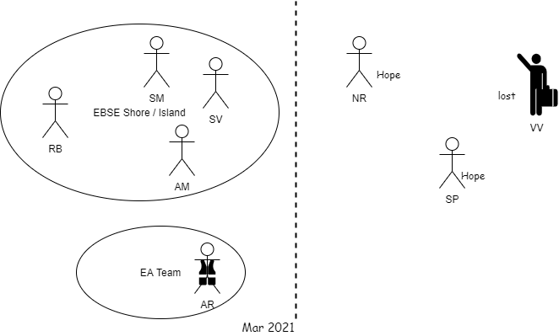
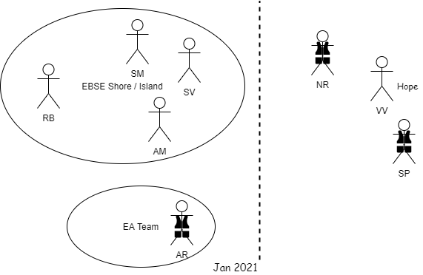
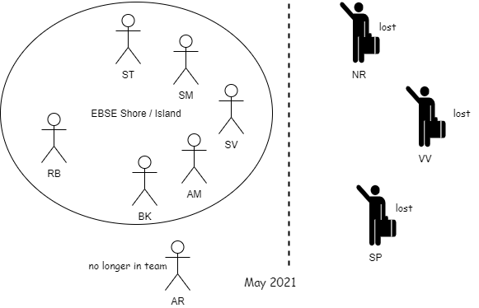
…how it ended

Slide 4
greenfield project
The legacy E&B was served by Mainframe system for more than 30 years; several attempts at replacing that with modern API had failed
EBSE was started to bring down mainframe maintenance cost, serve benefits from source systems, to be scalable and with top class control/ alerts
It was established by a new team formed by borrowing from PMT and hiring new members
On application design this followed many firsts within the organization, which included: SpringBoot, Gradle, MongoDB, OpenShift, Jenkins to state a few; along with parallel calls, circuit breakers, auto-scaling, rolling deployments, etc

Slide 5
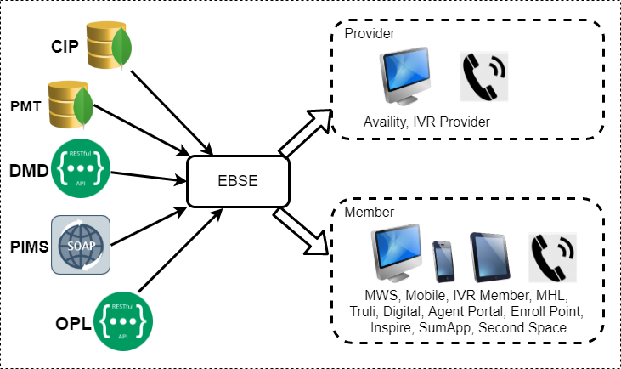
a simple design
Components were segregated by broad channel types
The API service for tier 1 channel was kept separate from others
Even though there were total of 4 API services, they were kept as a single monolithic application
It was not un-necessarily broken into micro services architecture

Slide 6
attention to details
OpenShift
DB Calls
Rest
SOAP
MQ
Client channels
Gateway/ Edifecs
Secure Proxy Srv
Data Power
Application
Controller
Service layer
Backend layer
Controls
Alerts
Dash Boards
Transaction chaining
Key aspect of the application design was intercepting at each critical point of call invocation and logging essential data
Call chaining from invocation, starting with client app all the way through each hop was so important in giving valuable insight

Slide 7
phased approach
timeline
2017
Discovery, analysis, tech release
2018 Q1
IU65, SG ACA
2018 Q2
IU65, SG preACA, LG std
2018 Q3
O65
2018 Q4
LG grp sp, LG steerage
On-going
Many integrations added
Dec 2020
Team fractured
Dec 2016 Inception
Mar 2019 Warranty end
Among the key aspects of implementation was a large discovery work; analyzing each aspect of mainframe application
Technical implementation of API was completed first followed by thorough testing of build infrastructure on OpenShift
Delivery was divided into phases: the new App was progressively loaded with transactions per segment per phase, keeping Mainframe app serving the rest traffic in parallel
After all phases were transitioned to new App, and warranty period was crossed, the mainframe app was retired
Later, the new App onboarded several new integrations, expanding the clientele of the services provided

Slide 8
operational excellence
Maintaining a bin list of improvement items
Taking up these improvements at slightest opportunity
Continuously monitoring production system and identifying improvements
Regularly scanning code through SonarQube and refactoring the application
Maintaining up to date documentation of the design as well as the process around the application support
Interacting with interfacing teams .. Being responsive to queries and tickets and establishing a solid rapport with all

Slide 9
Shelf-life vs non-functional code
testability
Reducing complexity
fitness function
logging, cntrol/ alerts
performance
security
feature code
requirements
Unit, functional, integration testing
data
fitness function
legality
Scalability/ OpenShift
Mar 2018
Jun 2018
Aug 2018
Dec 2018
Dec 2020
Dec 2040

Slide 10
The Magic team
Dedicated Architect working at highest level of abstraction
Constantly recording documentation and always keeping it up to date
Providing direction, theme/ central idea to the team
Main theme = 24x7 availability and decades long shelf life; “operation support is at the heart of the application design”
Analysts working at deep dive level; thorough understanding of source system data and data-wiring
Benefit translation and complete understanding of source data
How the translated data is consumed by downstream/ its context
Exceptional ops support, data-analysis with depth of knowledge
QA ensuring quality of information served at Availity as well as matching with Expectation from Business
The only limitation was using manual testing from external UI App; remaining testing was driven by developers
Developers working at lowest level of abstraction
Each developer pays close attention to quality of service; developers not only taking deep dive within the realm, they also went out of realm
Team is providing SME-expertise to upstream and downstream channels

Slide 11
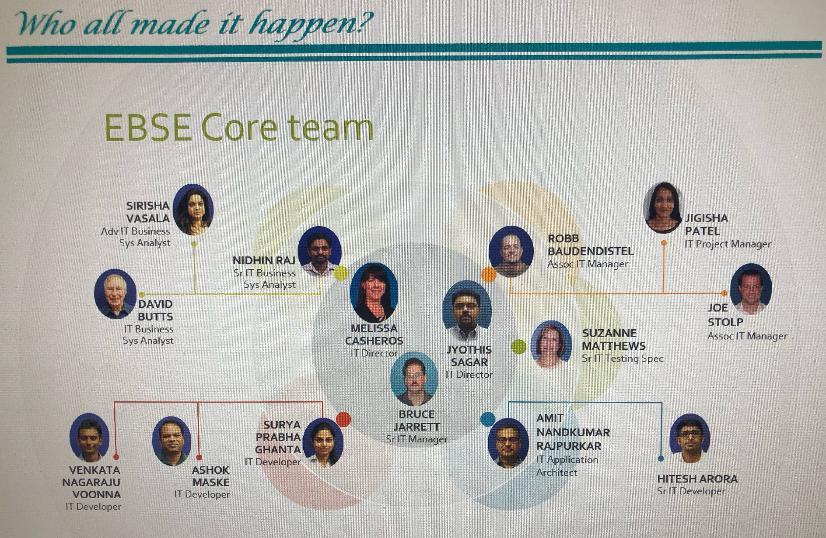
The team

Slide 12
The developers
Complete handle on code base and self driven
Not just expertise on java, spring framework and related technologies
Having insight and adhere to clean code practices, actively working on simplifying/ improving code; use SonarQube
Developers distribute workload amongst themselves and deliver features end-to-end (code-complete)
Full understanding of data, how/ why it is used as per design
How benefits are designed in source system and how data is made available in cache db
How the member data is designed and made available in respective cache
How the accumulator data was arranged with benefits
DevOps oriented
Each developer was an expert working with Gradle, GIT, Jenkins,
Work along side infra teams, gain expertise on OpenShift
Always going above/ beyond in testing/ QA
Fill up void of test team; not just unit test but also end-to-end functionality test
Test from perspective of end channels too
Test data arrangement
Work along side organization teams and help arrange test data for the application too
Full grip on underlying source app and the tier 1 client app
Keep a thorough understanding on how the response data appears on the tier 1 client

Slide 13
Role played by developers
Understanding boundaries of architecture
architecture
Understand scope
Participate in analysis
Understand how mapping works
req analysis
Structure of packages/ classes
Libraries dependencies
Updating framework/ lib versions
design
Feature development
Refactoring/ sonarqube analysis
Code cleanups/ re-organization
build/ code
Unit test Eclipse debugger, postman, soapui
Regression tests (nothing should be broken)
Edge case tests (manual, -ve scenarios)
End to end tests
Test data management
Performance testing – jmeter, boomi
QA/ testing
Watch alerts, reports, dashboards
Identify issues, initiate hotfixes
Continuous improvements
R ticket analysys
Ops support

Slide 14
The team on the whole
Self managed team
Project planning, task assignments, delivery, task-tracking was all managed by team members themselves
Working shoulder to shoulder
Developers distribute their workload
Developers work hand in hand with analysts and QA
Informal code reviews/ developer sessions
Being proactive in reviewing with each other any key deviations in code/app-design
Design sessions
Analysts will actively have design sessions with developers for any new requirements
Many times developers also drive design sessions, as feedback loop after digging through implementation
Continuous improvements
Each team member contributed to continuous improvement
Contributing above/ beyond
None of team members settled with 9-5 job,
Each one contributed into areas beyond their individual scope to make End to End possible
Many worked after hours too for additional research/ analysis to achieve improvements
Delivering Quality of Service as a whole
The team overall, checked on each aspect of Quality of Service

Slide 15
Quality of Service
Quality of Work
Value of Work
Delivered by individuals, teams
This can include the quality of task completion, interactions, and deliverables
Fit for purpose
Conformance to requirements
Completeness
Correctness
Accurate
Diligence
Professional
Communication
Compliance
Controls
Best Practices
Risk
Integration
Usability
Customer friendly
Relevant
https://simplicable.com/new/work-quality

Slide 16
What could have been better
The invaluable talent that was available as top-quality self driven team members should have been kept
Dedicated resources which were lost are not replaceable
Even the immediate supervisors were kept in dark about the team members tenure
The uncertainty and lack of information/ foresight was the bad part
Had it been known that organization was only going to throw away valuable team members, we could have ended in better way

Slide 17
On a positive note..
The experience that each team member gathered over these years on this project has been invaluable
The success stories (several of them) that each one experienced will remain as good guidelines for us for future reference
The team spirit seen by this project team is something that each one will try to re-create in new environment

